Slide 1
TP48200A DG START DELAY
Introduction
This process will delay dg start when Umeme is not available at site. The generator will only start after attaining the set DOD/SOC
The process is similar to the common mode of DG delay executed by the delta rectifiers.
The only difference is that the TP48200A uses SOC/DOD to trigger a DG start/stop
Steps involved in the activation of the function
-Clearing all alarm associates on Alarm relay output 2
-Enabling DOD mode
-Setting DOD thresholds (upper and lower)
-Communication cable connections (TP48200A to ATS)
All these can be executed manually.
User name: admin
Password:000001
Compiled by – David Bbosa

Slide 2
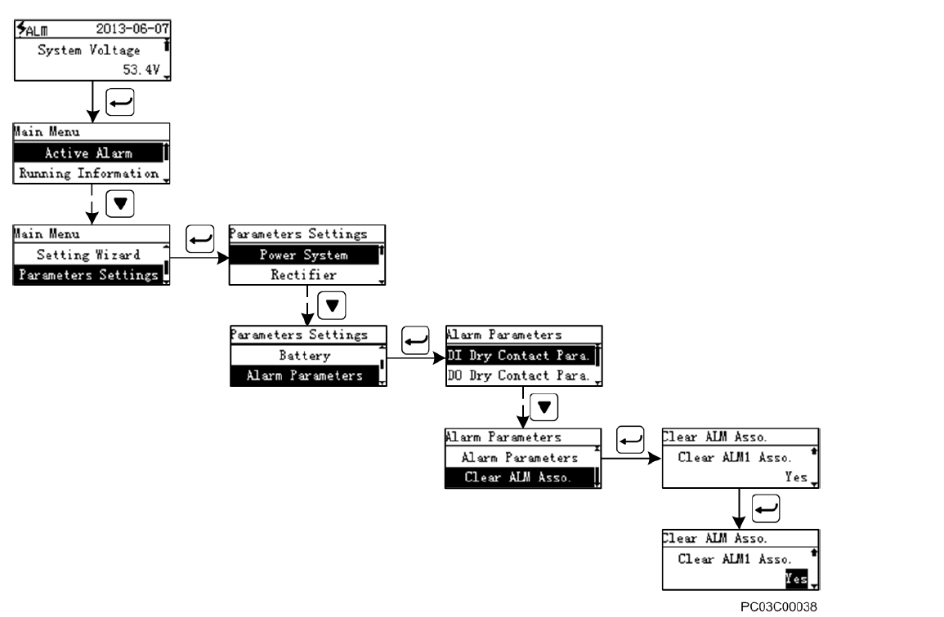
Clearing Alarm associates on ALM2
The start/stop command comes through out put 2 (ALM 2), To prevent conflict of commands, all alarms configured to come through output 2 must be cleared the same way as below;

Slide 3
Setting/enabling DOD mode
The TP48200A executes all command basing on the DOD/SOC of the Back-up system .
The DOD mode must then be activated.
Quick steps;
We then set the DG function to DOD mode
Power system
Basic para
DG function
Menu
Parameter settings

Slide 4
Setting Start /stop thresholds
Start threshold is the value (dod) at which the DG will be commanded to start. This should be set to 50%.
Stop threshold is the value at which the DG will be triggered to stop, if Umeme is not restored and yet the batteries are full. This should be set to 100%.
All these commands depend on capacity, entered capacity must be accurate.
Steps;
we then set the two capacities (to start/stop the DG).
Parameter settings
Diesel Generator
Cap to start DG

Slide 5
Signal Cable connections
On the UIM board below, we use ALM2, DIN3 and DIN4
ALM2….. Connected to remote start/stop point in the ATS
DIN4……Connected to the DG run relay (com and NO) this sends a signal to the system when the dg is running.
DIN3…….Connected to Mains Relay (com and NO) this sends a signal to the system when site is loaded on mains

Slide 6
AOB
-Team must carryout tests to ascertain proper performance of the function.
-SOB alarm should be reconfigured as Site on hybrid
-The dg should be able to sense mains restoration, so that it goes off when Umeme is back. Not to wait till the batteries are full.
Thank you

